Slide 1
Kafka – 101
Made by a group that learned it recently ;)

Slide 2
Agenda for this course
- Docker
- Kafka
Kafka deep-dive
security
Kafka streams
Kafka connect
Kafka ksql
- Big project

Slide 3
Docker
Container Technology 101

Slide 4
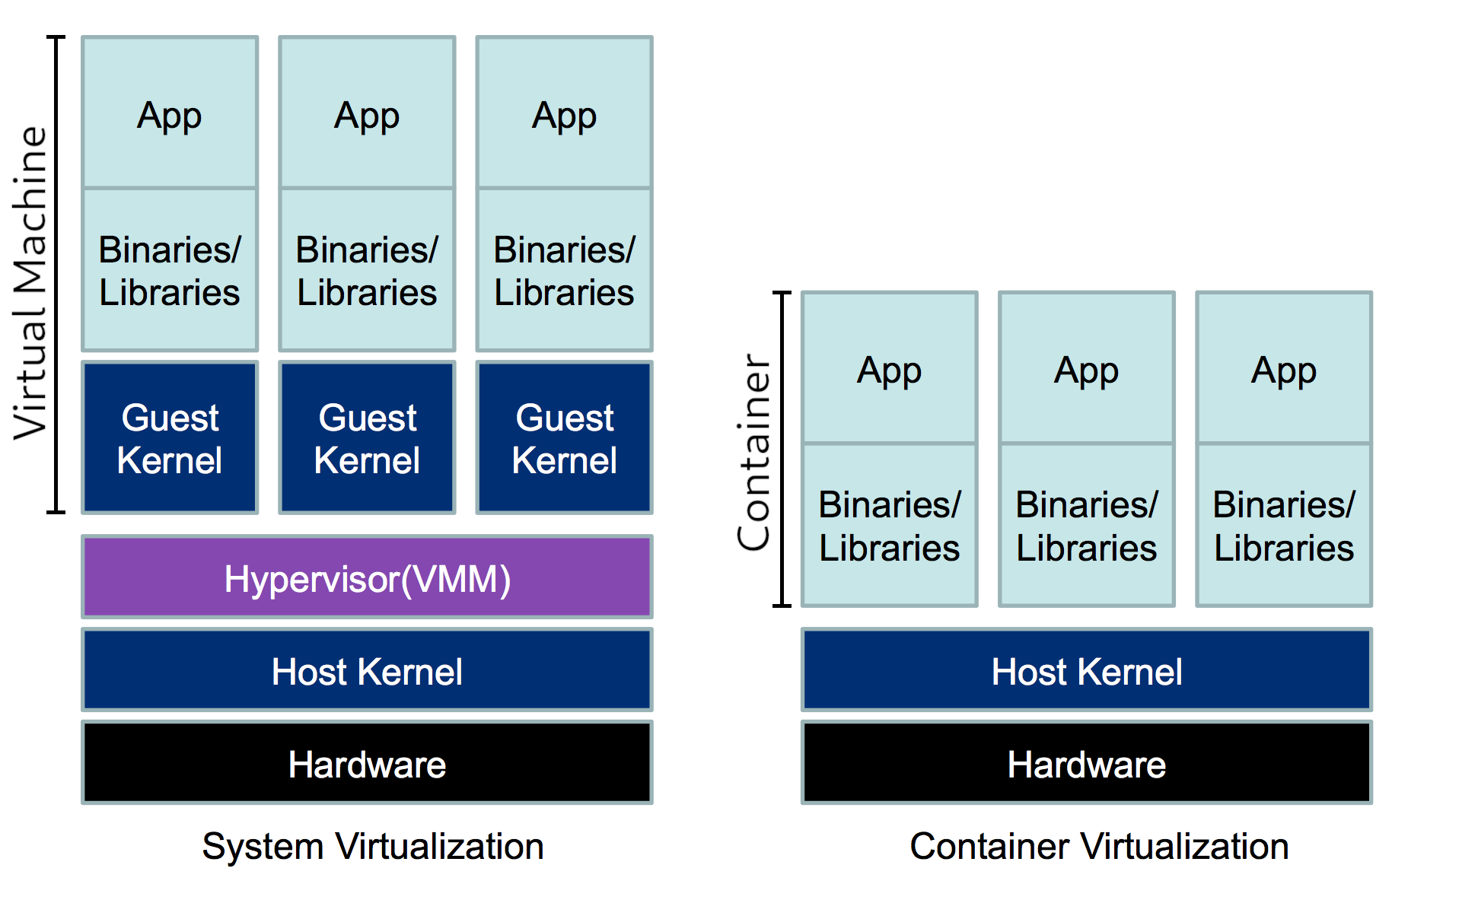
Containers are basically just light weight Virtual Machines. Docker runs containers
Virtual machine stack
Containerised stack

Slide 5
Introduction to Docker and Container Technology
Key Concepts:
Containerization
Isolation
Advantages:
Portability
Efficiency
Use Cases:
Microservices Architecture,
DevOps,
Local development
Notes:
Definition: Docker is an open-source platform that automates the deployment, scaling, and management of applications inside lightweight, portable containers.
Key Concepts:
Containerization: A lightweight, standalone, executable package that includes everything needed to run a piece of software, including the code, runtime, libraries, and system tools.
Isolation: Containers encapsulate applications, ensuring they run consistently across various environments without dependency issues.
Advantages:
Portability: Containers run consistently across different environments, promoting seamless migration and deployment.
Resource Efficiency: Containers share the host OS kernel, reducing overhead and optimizing resource utilization.
Use Cases:
Microservices Architecture: Ideal for breaking down monolithic applications into smaller, manageable services.
DevOps Practices: Enhances collaboration between development and operations teams by providing a consistent environment for development, testing, and deployment.

Slide 6
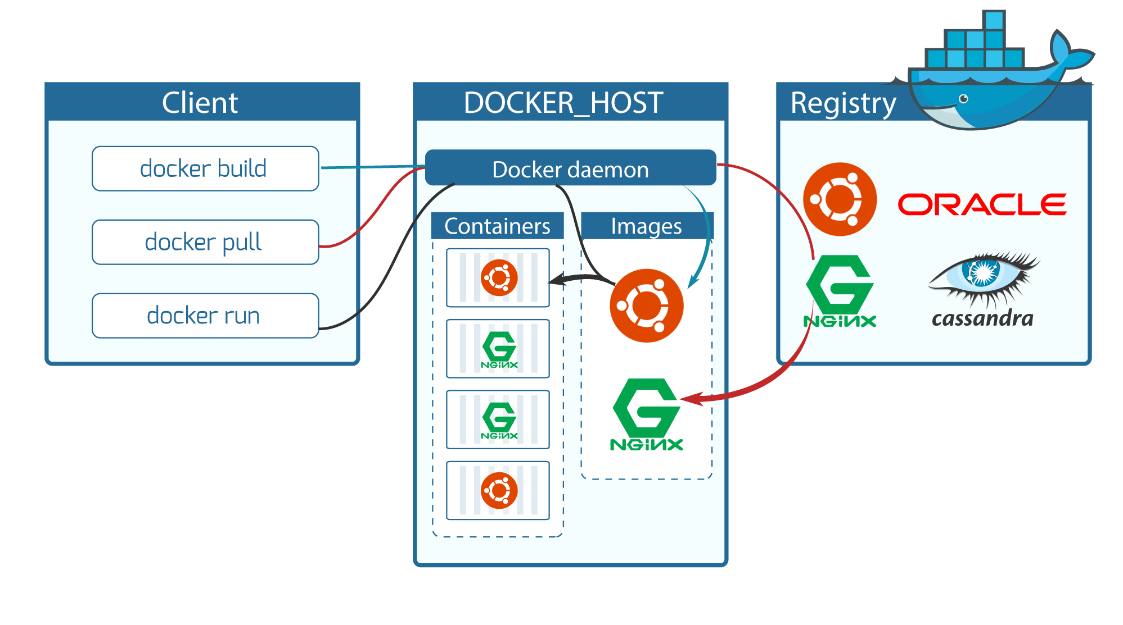
Docker Architecture and Components

Slide 7
Getting started
NB! Docker Desktop is a commercial product and there are licensing stuff to deal with
I recommend going full open source. That means:
Linux: install docker (or moby), or podman via package manager. Remember to add your user to the docker group!
Mac: Colima or podman
Windows: Rancher Desktop

Slide 8
Basic commands
docker pull: Download Docker images from a registry.
docker build: Create a Docker image from a Dockerfile.
docker run: Start a container from a specific image.
docker ps: View active containers.
docker stop/rm: Stop or remove a container.

Slide 9
Docker-compose
If you have a hairy setup (like we will have in this CG course), you can use docker-compose to streamline the process
It is a utility that reads a yaml file and runs appropriate docker commands
Lets you write complex setups declaratively rather than maintaing large scripts of docker commands

Slide 10
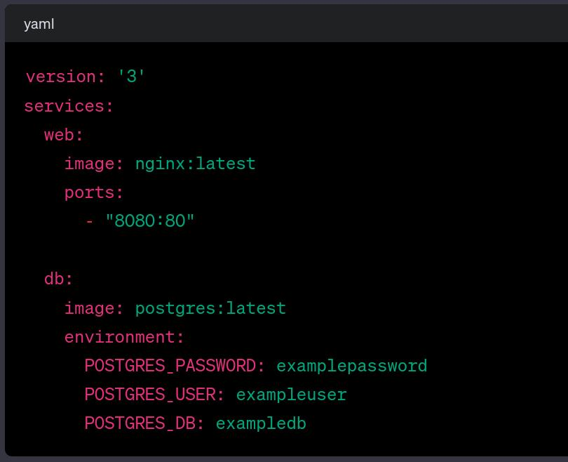
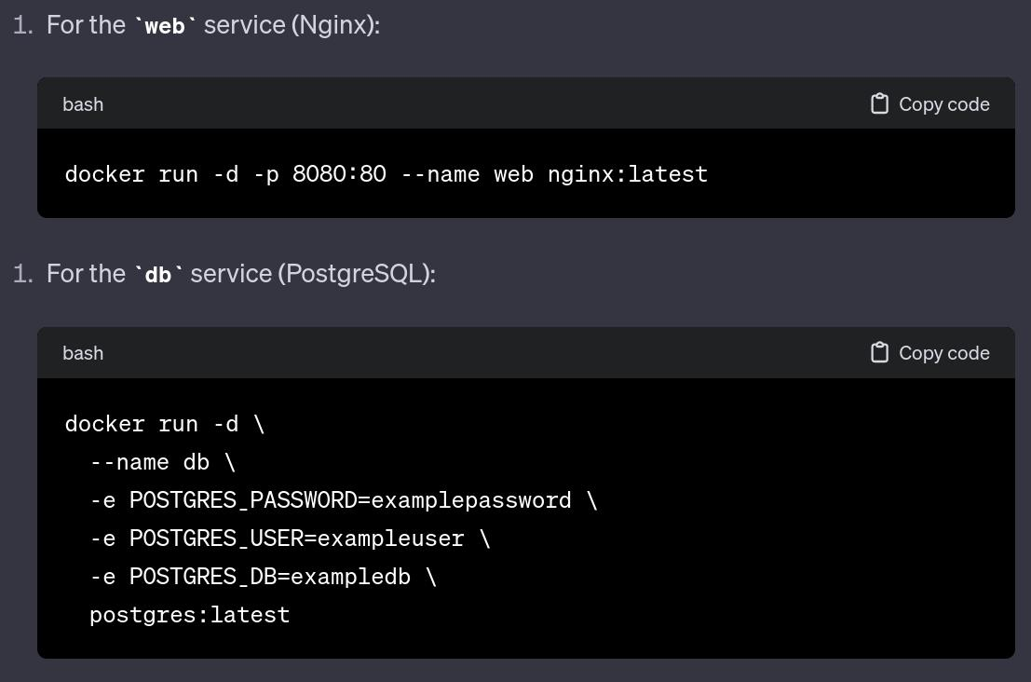
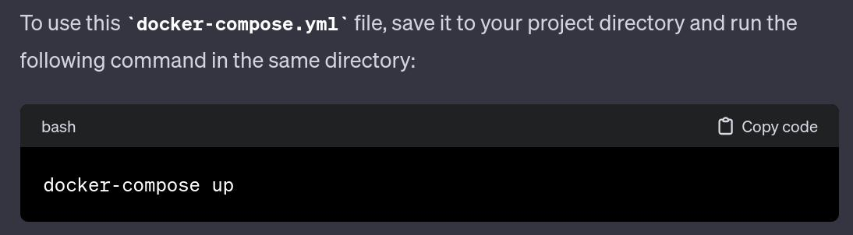
Docker-compose compared to plain docker commands

Slide 11


Slide 12
Kafka
https://www.gentlydownthe.stream/

Slide 13
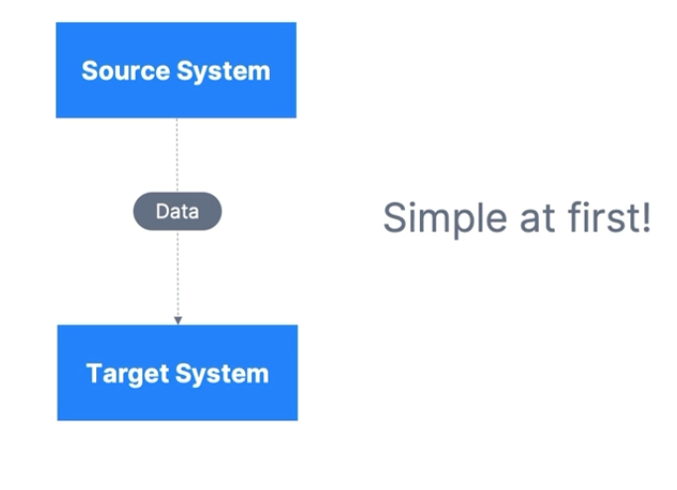
How companies start

Slide 14
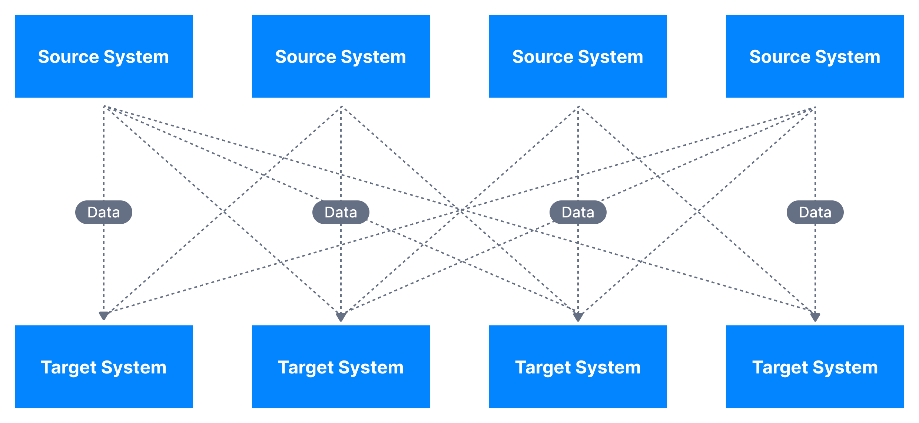
After some time…
A lot more complicated…

Slide 15
This causes problems..
4 source systems, and 4 target systems requires 16 integrations..
Each integration comes with difficulties around
Protocol – how the data is transported (TCP, HTTP, REST, FTP, JDBC…)
Data format – how the data is parsed (Binary, CSV, JSON, Avro…)
Data schema & evolution – how the data is shaped and may change

Slide 16
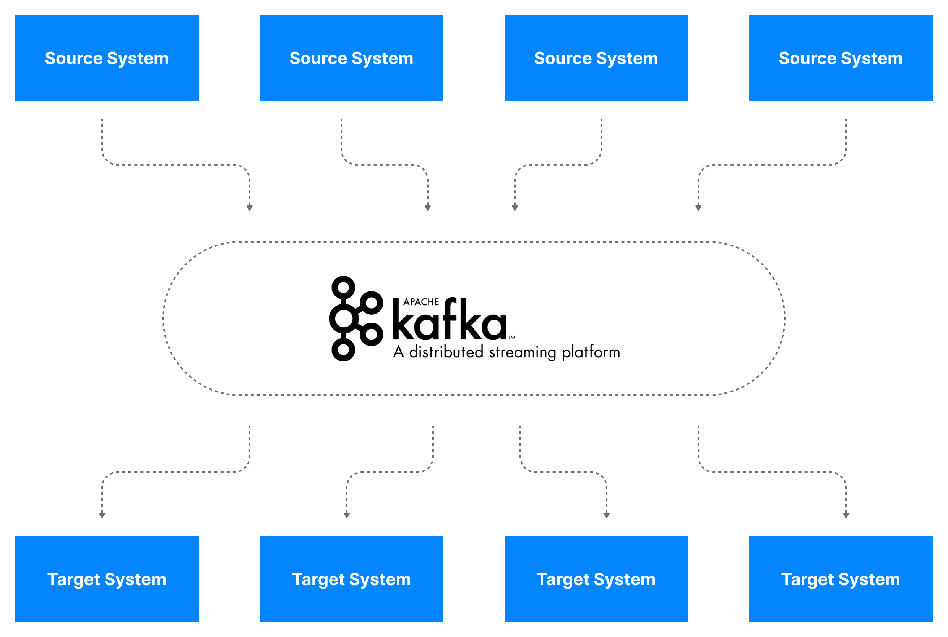
Kafka to the rescue!

Slide 17
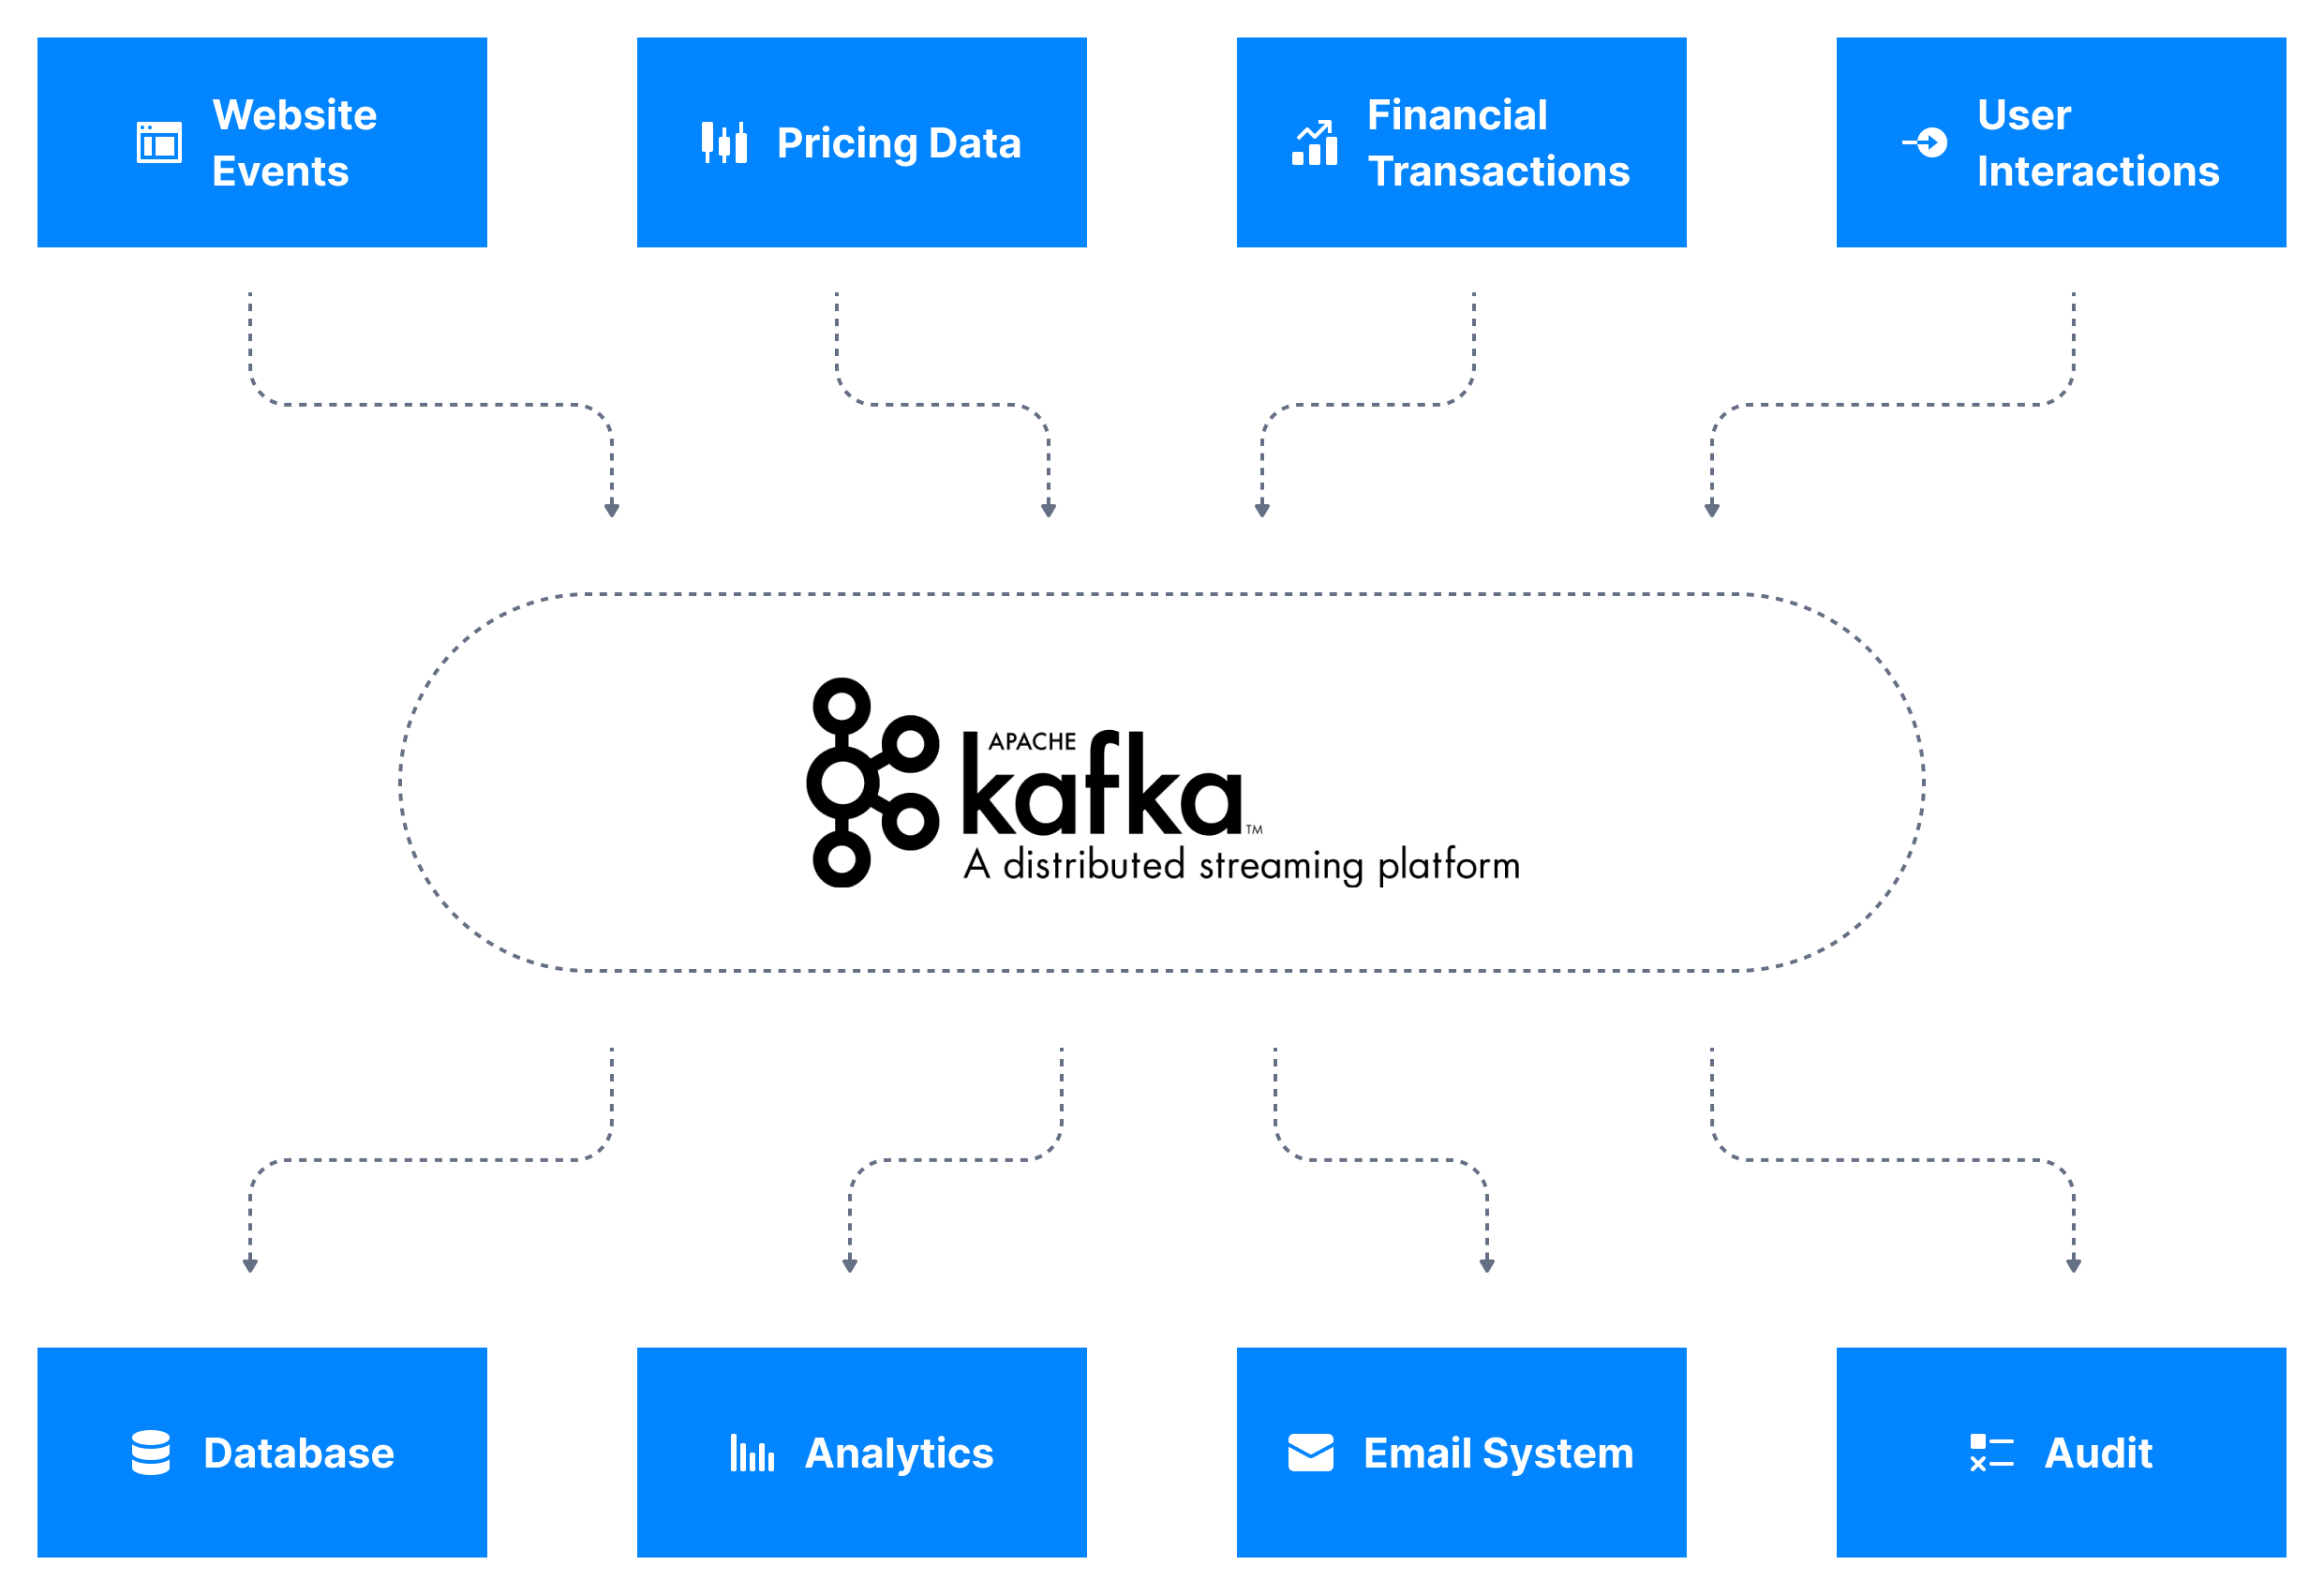
Even better example

Slide 18






Why Apache Kafka
Create by LinkedIn, now Open-Source project maintained by Confluent, IMB, Clourdera
Distributed, resilient architecture, fault tolerant
Horizontal Scalability
Can sacle to 100s of brokers
Can scale to millions of messages per second
High performance (latency < 10 ms) – real time
Used by 2000+ companies, 80% of Forune 100

Slide 19
Use cases
Messaging service
Acitivty Tracking
Gathering metrics from many different localtions
Application logs
Stream processing (Kafka streams API)
De-coupling of system dependencies
Integrations with Spark, Flink, Storm, Hadoop and other Big data tech
Mirco-services pub/sub
Event-sourcing store

Slide 20
Examples
Netflix uses kafka for recommendations in real-time while watching
Uber uses kafka to gather user, taci and trip data in real-time to compute and forecast demand, and compute surge pricing in real-time
LinkedIn uses kafka to prevent spam, collect user interactions to make better connection recommendations in real time.
Ruter uses it for something..
NB: Kafka is used as transportation mechanism of huge data flows that allow these features

Slide 21
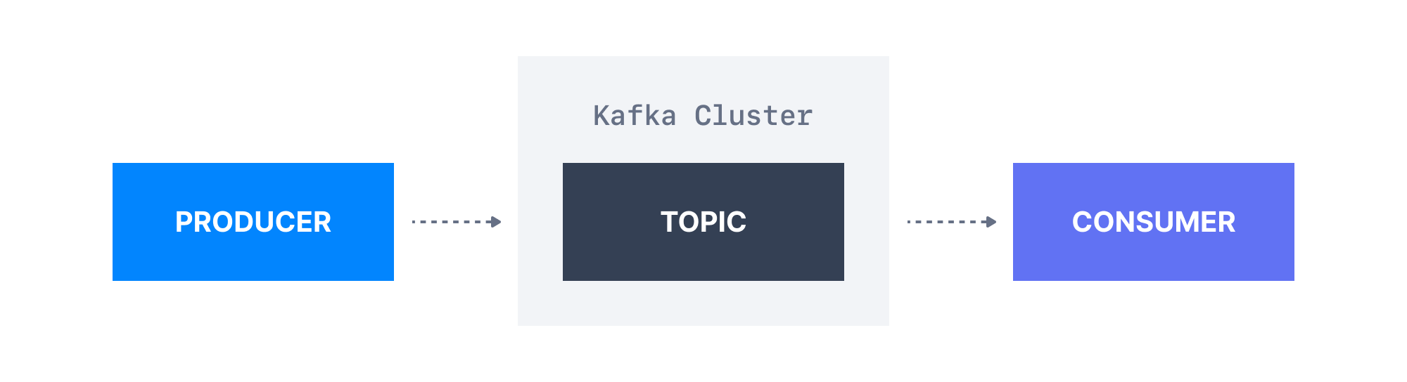
Lets understand kafka better

Slide 22
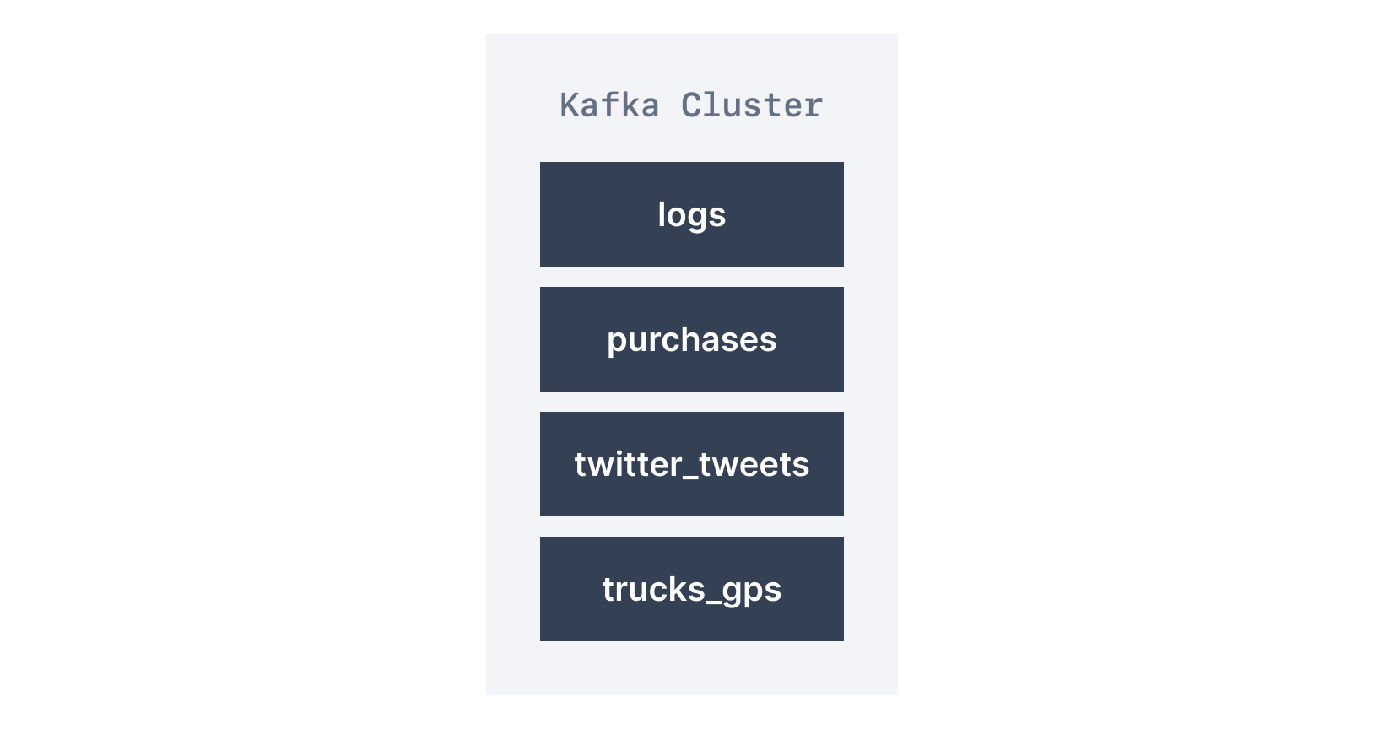
Topics
Topics: A particular stream of data
Like a table in a database
You can have as many topics as you want
Identified by its name
Any kind of message format
A sequence of measses is a data stream
Cannot query messages, use producers and consumer instead.

Slide 23
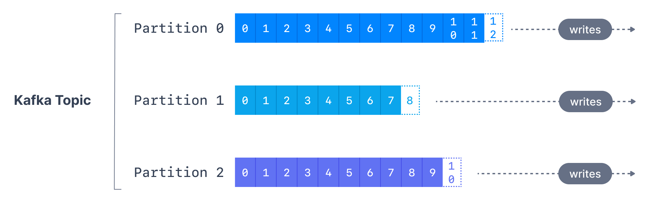
Topics – Partitions and offsets
Topics are split in partitions
Message within each partition are ordered
Each message within a patition gets an incremental ID, called offset
Kafka topics are immutable: once data is written to a partition, it cannot be changed

Slide 24
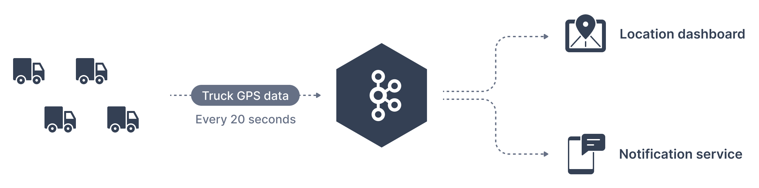
Topic - Example
Fleet of trucks, each truck reports its GPS position to Kafka
Each truck will send a message to Kafka every 20s, each message will contain the truck ID and the truck position(latitude and longitude)
You can have a topic trucks_gps that contains the position of the trucks
We choose to create a topic with 10 partisions (arbitrary number)

Slide 25
Topics – Important notes
Data in partitions is Immutable
Data is kept for a limited time (default 1 week - configurable)
Offset (ID) only has meaning for each partition
Offsets are not reused, or represent the same data between partition
Order is only guranteed within a partition

Slide 26
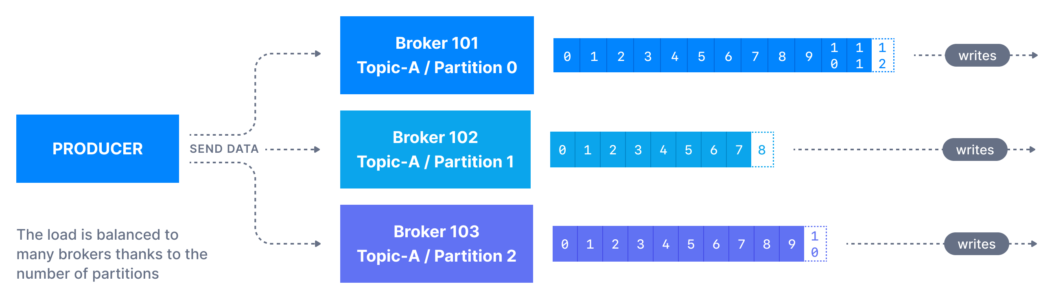
Producers
Producers write data topics (Which are made of partitions)
Prouducers know to which partition to write to (and which broker)
In case of kafka broker failure, Producers will recover

Slide 27
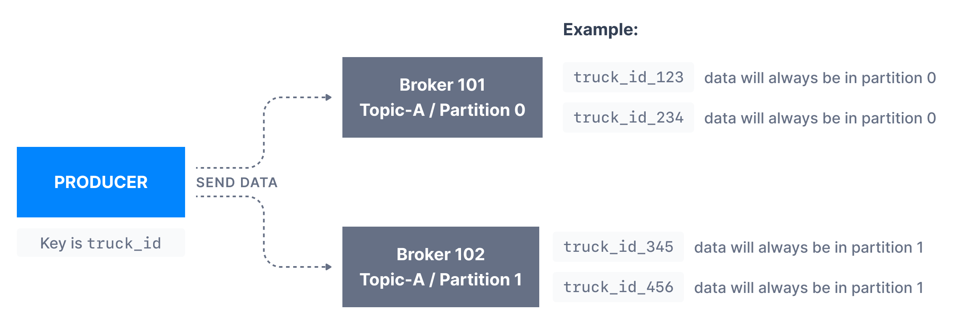
Producers – Message keys
Producers can choose to send a key with the message (string, number etc)
If key=null, data is sent round robin(partition 0, then 1, then 2)
If key != null, then messages with same key go to same partition(hashing)
A key is used for ordering (ex: truck_id)

Slide 28
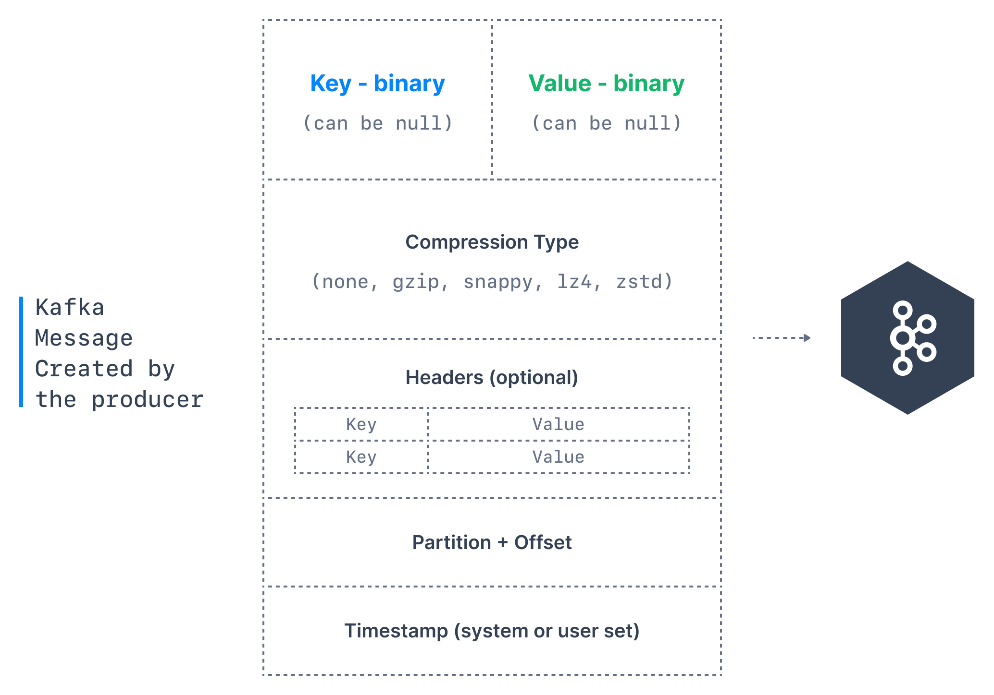
Producer – Message anatomy
Notes:
Key. Key is optional in the Kafka message and it can be null. A key may be a string, number, or any object and then the key is serialized into binary format.
Value. The value represents the content of the message and can also be null. The value format is arbitrary and is then also serialized into binary format.
Compression Type. Kafka messages may be compressed. The compression type can be specified as part of the message. Options are none, gzip, lz4, snappy, and zstd
Headers. There can be a list of optional Kafka message headers in the form of key-value pairs. It is common to add headers to specify metadata about the message, especially for tracing.
Partition + Offset. Once a message is sent into a Kafka topic, it receives a partition number and an offset id. The combination of topic+partition+offset uniquely identifies the message
Timestamp. A timestamp is added either by the user or the system in the message.

Slide 29
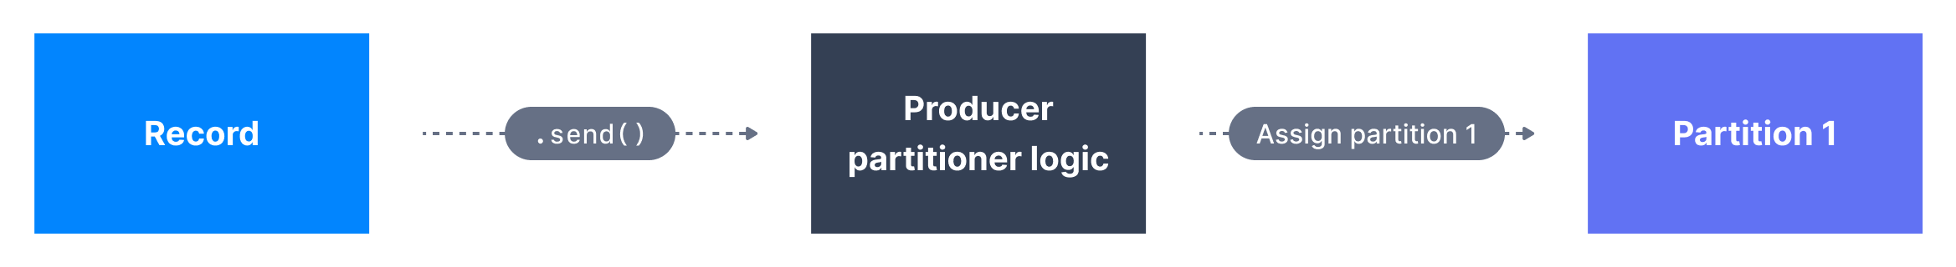
For the curious: Kafka message key hashing
Kafka partitioner is a code logic that takes a record and determines to which partition to send it
By default, Kafka partitoner uses the murmur2 algorithm
targetPartition = Math.abs(Utils.murmur2(keyBytes)) % (numPartitions - 1)
NB: Change numPartitions and ordering is no longer guaranteed…

Slide 30
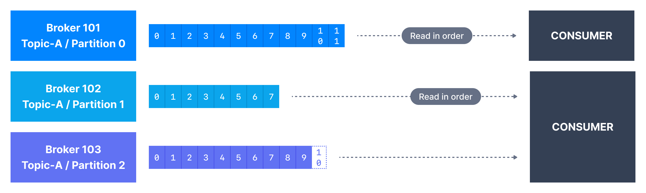
Consumers
Consumers read data from a topic – pull model
Consumers automatically know which broker to read from
In case of broker failure, consumers will recover
Data is read in order, from lowest offset(id) to highest in each partition

Slide 31
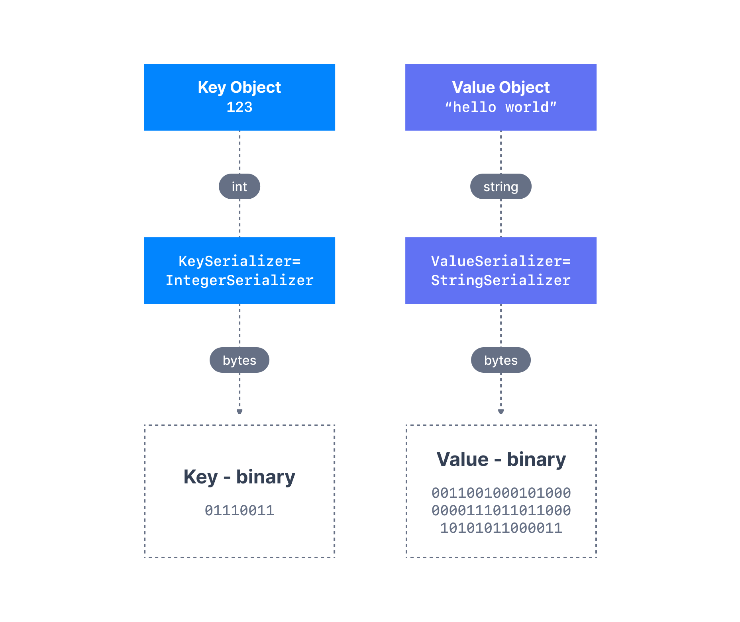
Producer – Message Serializers
Kafka only acceps and sends bytes as input and output
Seralization is used for key and value
Common Serializers
String(incl. JSON)
Int,Float
Avro
Protobuf

Slide 32
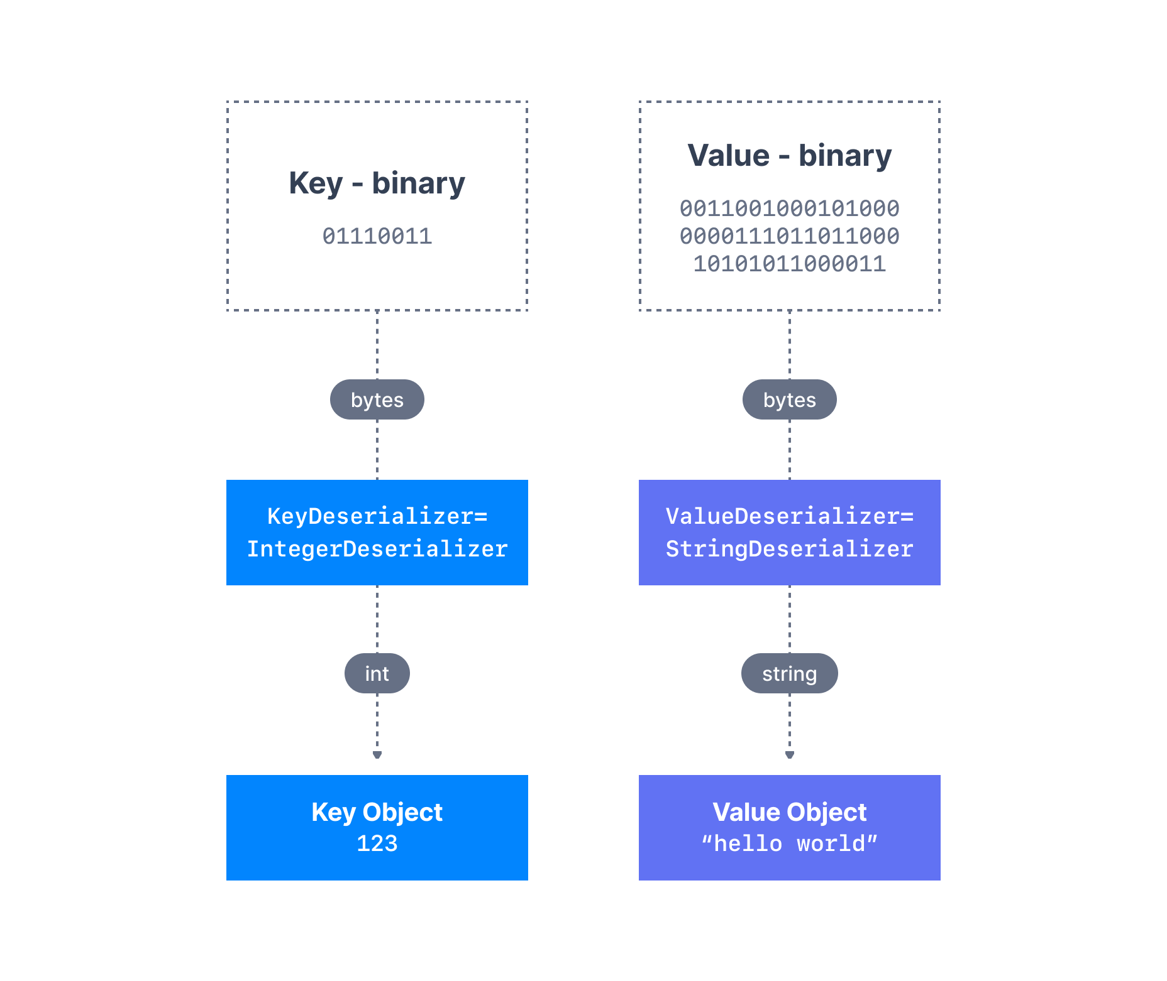
Consumer Deserializer
Deserializer is used for value and key
Common Deserializer
String (incl. JSON)
Int, Float
Avro
Protobuf
The serialization / deserialization type must not change during a topic lifecycle (Create new instead)

Slide 33
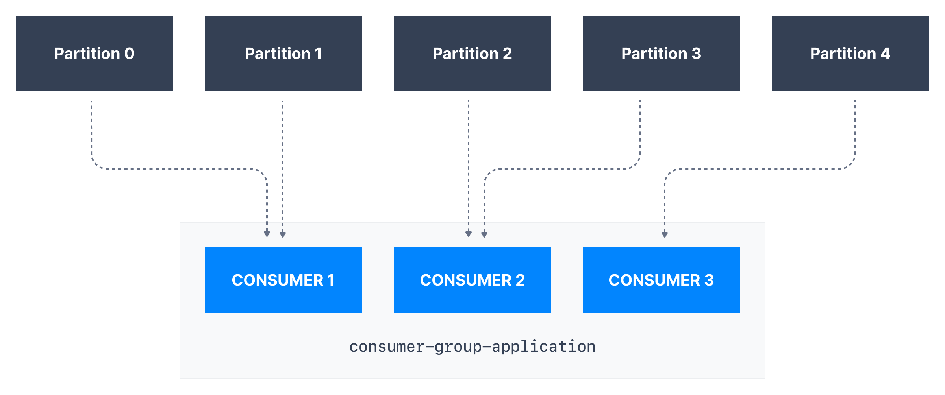
Consumers groups
All the consumers in a application read data as consumer groups
Each consumers within a group reads from exclusive partitions

Slide 34
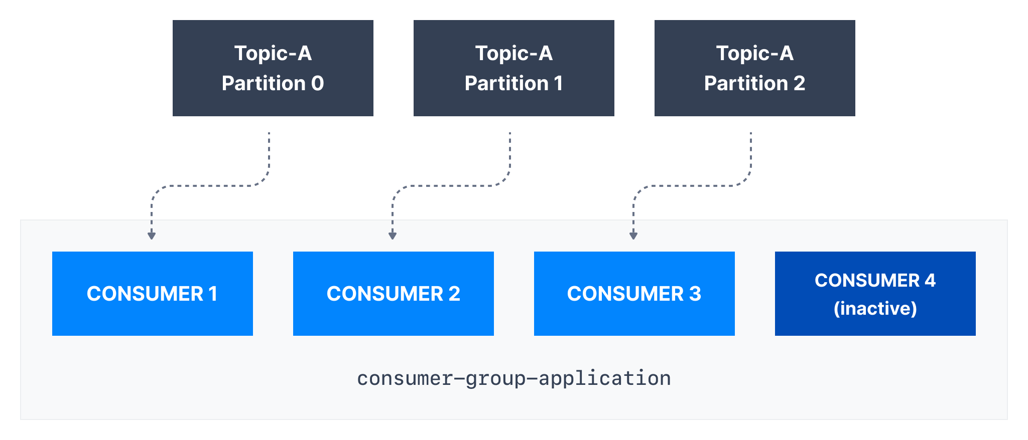
Consumers groups – What if too many consumers?
If you have more consumers than partitions, some concumers will be idle

Slide 35
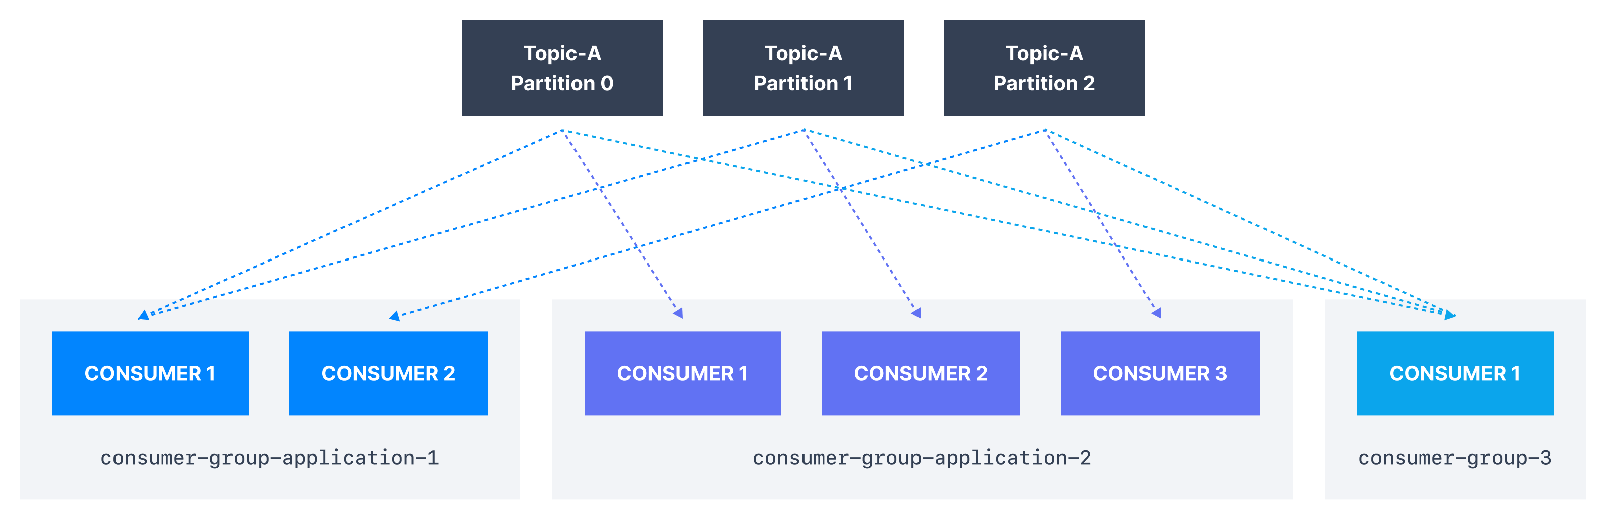
Multiple consumers on one topic
You are allowed to have multiple consumer groups on the same topic
To create distinct consumer group, use the consumer property group.id

Slide 36
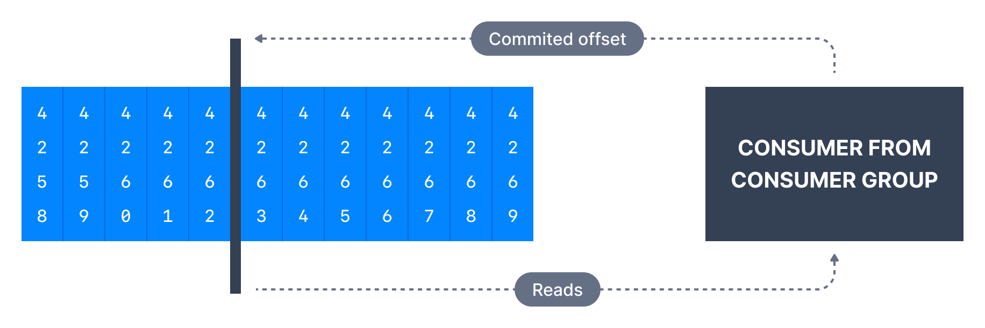
Consumer Offsets
Kafka stores the offsets at which a consumer group has been reading
The offests committed are in a kafka topic named __consumer_offsets
When a consumers processes data it will periodically commit the offset
If consumer dies, it will be able to resume because of the saved offsets

Slide 37
Delivery semantics for consumers
By default, Java consumers will auto-commit offsets (at least once)
There are 3 delivery semantics if you choose to do it manually
At least once
Offsets are commited after message is processed
Duplicates in case of errors, Idemponent consumers is important!
At most once
Offsets are committed as soon as message is reaceived
Messages can be lost
Exactly once
For kafka => Kafka Transactional API (Kafka Streams API)

Slide 38

Brokers
A kafka cluster is composed of multiple brokers
Each broker is a identified by ID
Each borker containts a certain topic partitions
Each brokers is a bootstrap server, access point to all other brokers
3 brokers is a good starting point, but some clusters have over 100

Slide 39
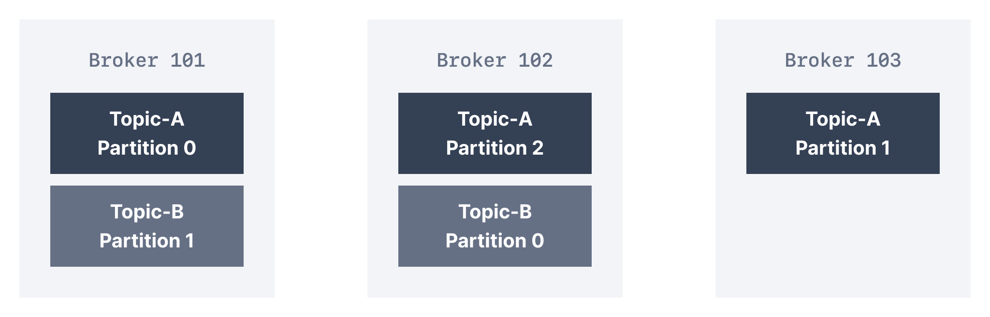
Brokers and topics
Example of Topic-A with 3 partitons and Topic-B with 2 partitions
Note: Data is distributed, and broker 103 doesn’t have any Topic-B

Slide 40
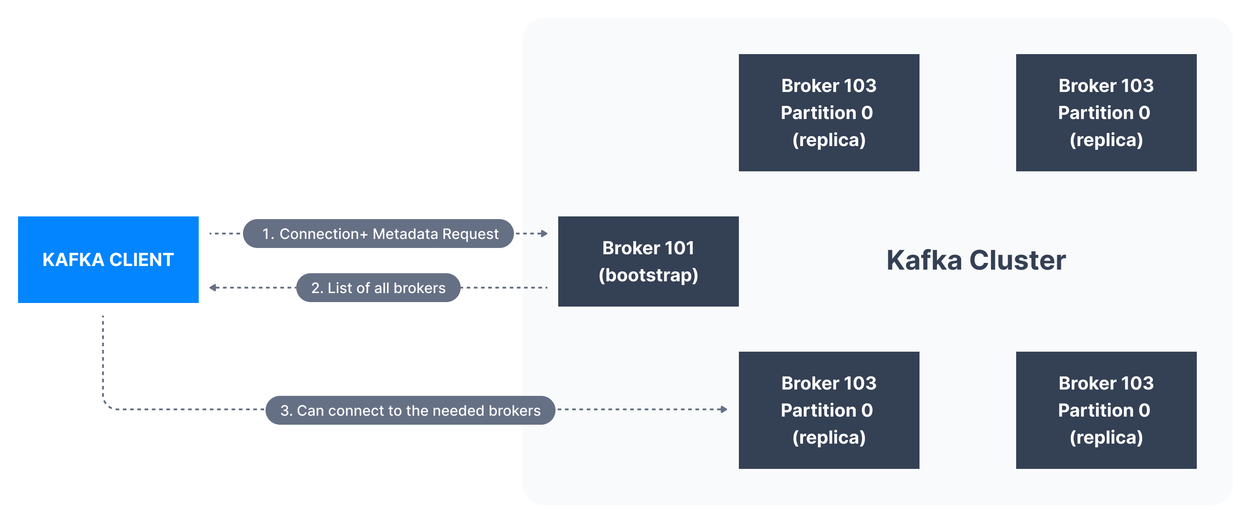
Kafka Broker Discovery
Every Kafka broker is also called a “Boostrap server”
That means that you only need to connect to one broker (Smart clients)
Each broker know about all brokers, topics and partitions

Slide 41
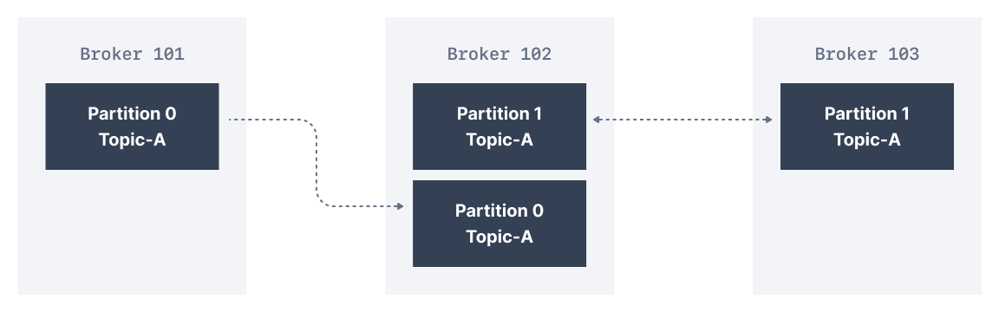
Topic replication factor
Topics should have a replication factor > 1 (usually between 2 and 3)
This way if a broker goes down, antoher broker can serve the data
Example: Topic-A with 2 partitions and relication factor of 2

Slide 42
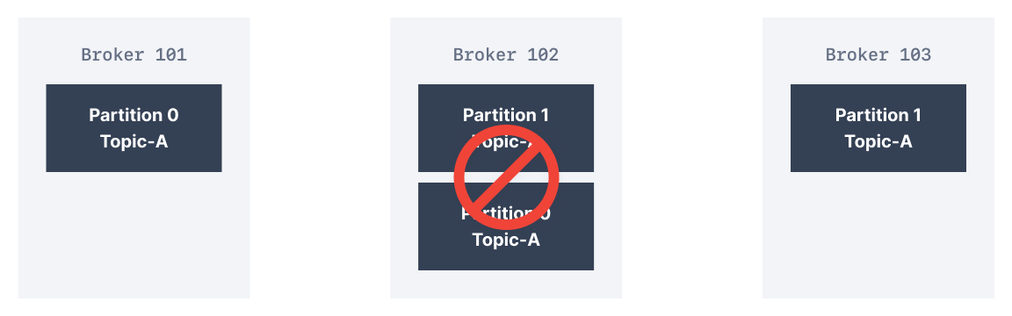
Topic replication factor
Example: We lose broker 102
Result: Broker 101 and 103 can still serve the data
Note: As a rule, for factor N you can lose up to N-1 brokers and still recover data

Slide 43
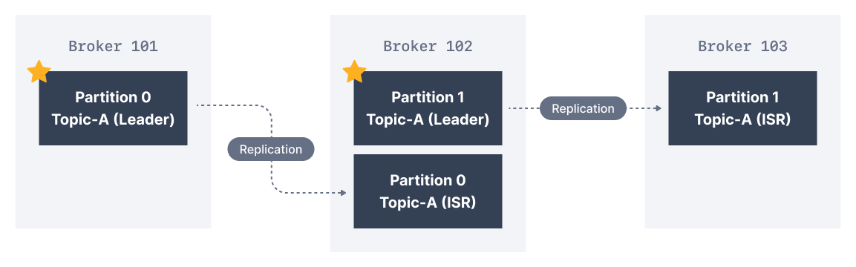
Partition leader
At any time only one broker can be a leader for a given partition
1 preffered leader chosen on topic creation
Leader election if it goes down
Producers can only send data to the broker that is leader of a partition
Each partition has one leader and multiple ISR(in-sync replica)

Slide 44
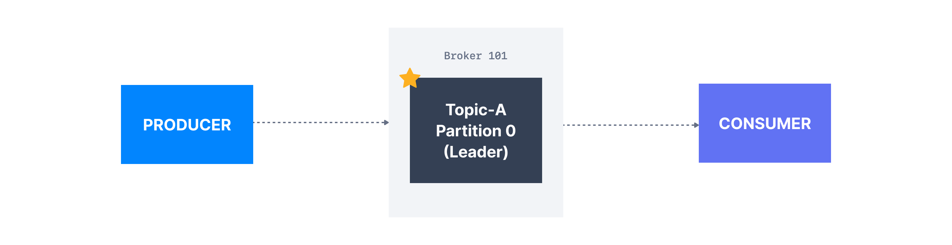
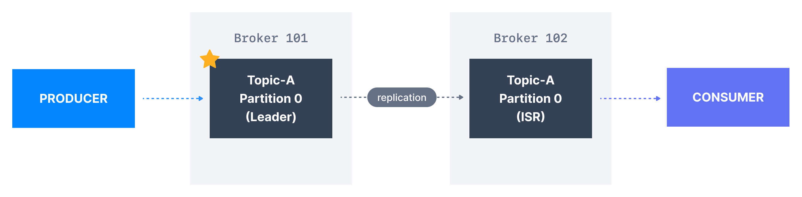
Default behavior for Producer/Consumer
Producers send to the leader of the partition
Consumers read from the leader, but can also read from replicas (>= v2.4)

Slide 45
Producer Acknowledgements (acks)
Producers can choose to receive acknowledgments of data writes
acks=0: Producers won’t wait for acknowledgement (possible data loss)
acks=1: Producers will wait for leader acknowledgment (limited data loss)
acks=all=-1: Leader + replicas acknowledgment (no data loss)

Slide 46


Zookeeper
Zookeeper manages brokers (Keeps a list of them)
Zookeeper helps in performing leader election
Zookeper sends notifiction to kafka in case of changes (e.g. new topic, delete topics, broker dies, etc…)
Kafka 2.x cant work without zookeeper
Kafka 3.x can work without Zookeeper – Kafka raft
Kafka 4.x will not have Zookeeper

Slide 47
Should you use Zookeeper?
With kafka brokers
Kafka Raft (KRaft) is production ready as of 3.3 (now 3.6)
4.0 is planned to be released in April 2024
Yes & No
With Kafka Clients
Over time, the kafka clients and CLI have been migrated to leverage the brokers as connection endpoint

Slide 48
About Kafka KRaft
In 2022, the Apache Kafka project stated to work to remove Zookeeper
Zookeper shows scaling issues when kafka clusters have > 100 000 partitions
By removing Zookeeper
Ability to scale to millions of partitions, easier to maintain and set up
Improved stability, easier to monitor, support, and administer
Single process to start Kafka
Single security model for the whole system
Faster controller shutdown and recovery time

Slide 49
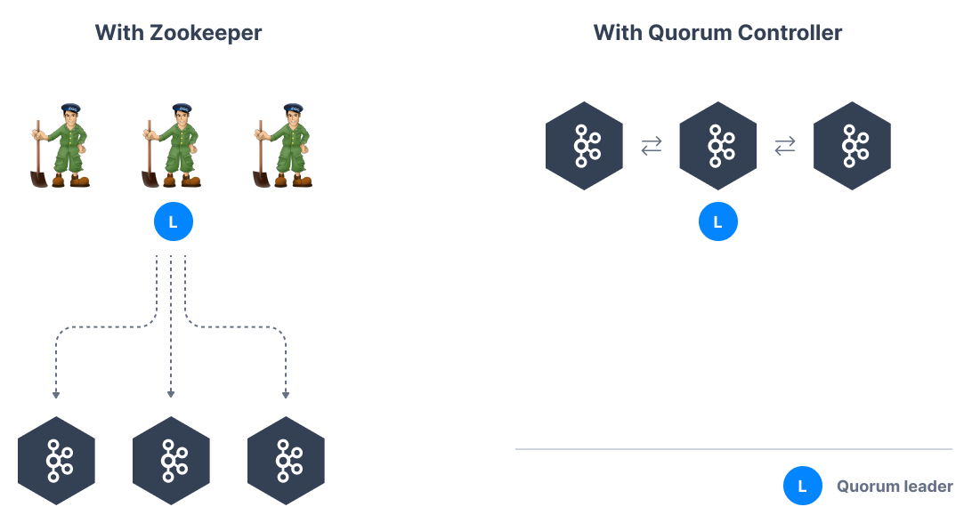
Kafka KRaft - Architecture

Slide 50
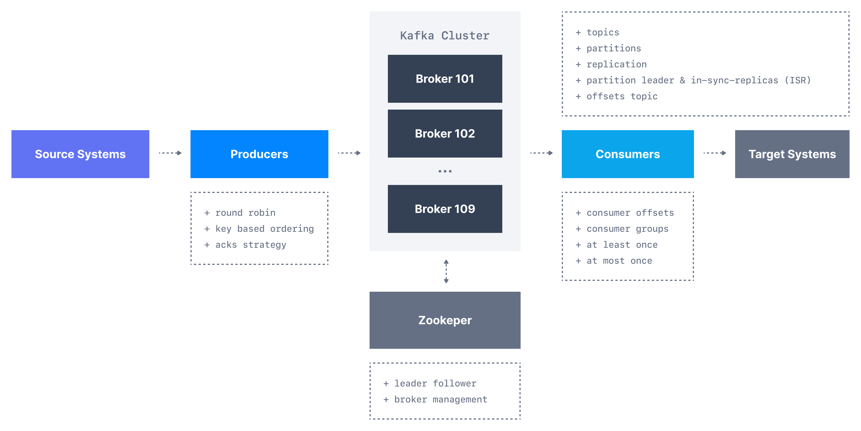
Theory – Round-up

Slide 51
Sources – since that is important now a days
https://www.udemy.com/course/apache-kafka/
https://www.conduktor.io/kafka/
Most of the kafka images are from here

Slide 52
To the tasks!
GitHub
CLI
Code
Forum
Are you done? Have some fun
Extra folder in workshop1

Slide 53
For next time
Kafka Security
How does this work?
Kafka Streams
Manipulations of data for multiple topics
Kafka Connect
Code by others for sending data to and from kafka easier
Kafka ksql
SQL like querying of Kafka topics
Kafka Schema Registry
Common format and validation for messages for topics

Slide 54
Takk for nu!
https://forms.office.com/e/7w0jzgRtpx

